Slide 1
Local Homeless Prevention Aid

Slide 2
Local Homeless Prevention Aid
Aid to county governments distributed by Minnesota Department of Revenue
Amount per county calculated based on:
Share of state population
Rate of student homelessness
Minimum of $5,000 per county
$20 million per year, paid in two installments
Initial county allocations will be determined by August 1, 2022.
First installment ($10 million total) in July 2023. Second installment in December 2023.
Final payment in December 2028, unless extended by the Legislature.
Legislative intent and justification based on Homework Starts with Home.
Legislative purpose is “to help local governments ensure no child is homeless within a local jurisdiction by keeping families from losing housing and helping those experiencing homelessness find housing.”
Funds can go to a wide variety of new or existing projects or programs.
Counties must report on use of funds.
Significant local discretion in use of funds.
Full legislative details: Minnesota Session Laws 2021, 1st Special Session, Chapter 14, Article 7, Section 3. https://www.revisor.mn.gov/laws/2021/1/Session+Law/ Chapter/14/#laws.7.3.0

Slide 3
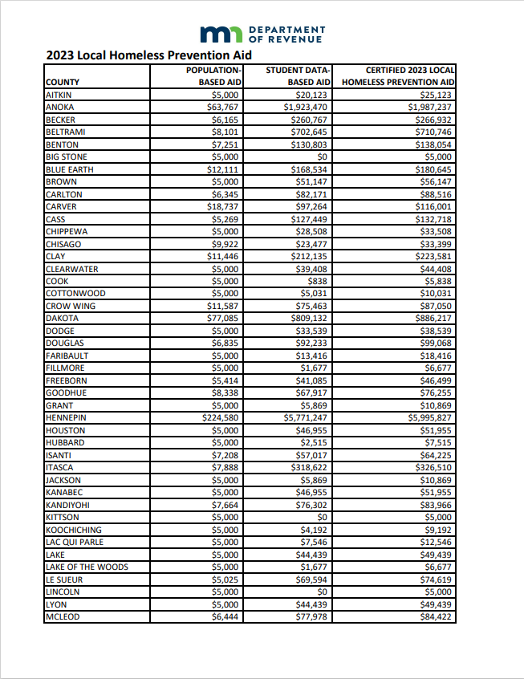
How much does this mean for each county?
County allocations published by the Minnesota Department of Revenue using formula defined in statute, based on data from the Minnesota Department of Education.
2023 Certification presenting 2023 funding levels by county available here: https://www.revenue.state.mn.us/ local-homeless-prevention-aid

Slide 4
Potential activities and next steps
Funded activities may be administered by a county, a group of contiguous counties jointly acting together, a city, a group of contiguous cities jointly acting together, a Tribe, a group of Tribes, or a community-based nonprofit organization.
Additional resources and design considerations that communities implementing Local Homeless Prevention Aid may wish to consider are provided here:
https://mich.mn.gov/ local-homeless-prevention-aid
Funded activities must include plans for:
Targeting homeless or at-risk families with PreK – 12 children
Targeting unaccompanied youth in need of an alternative residential setting
Connecting families with the social services necessary to maintain the families' stability in their homes
Providing one or more of the following:
Rental assistance
Support and case management services to improve housing stability

